Slide 1



DHIS2 & HISP
Introduction to DHIS2

Slide 2

DHIS2 & HISP
HISP
Notes:
It’s impossible to talk about +DHIS2 without mentioning the +HISP program and HISP groups.

Slide 3

DHIS2 & HISP
HISP
Notes:
But what +exactly is a HISP group, and how do they work with DHIS2? In this video, we will provide an overview.

Slide 4


HISP and the origins of DHIS2
Health Information Systems Programme
HISP
DHIS
Notes:
Let’s start with the original +Health Information Systems Programme, or +HISP, which developed version 1 of the +DHIS software in post-Apartheid South Africa in 1994 as a +collaboration between the University of Oslo and the University of the Western Cape.

Slide 5
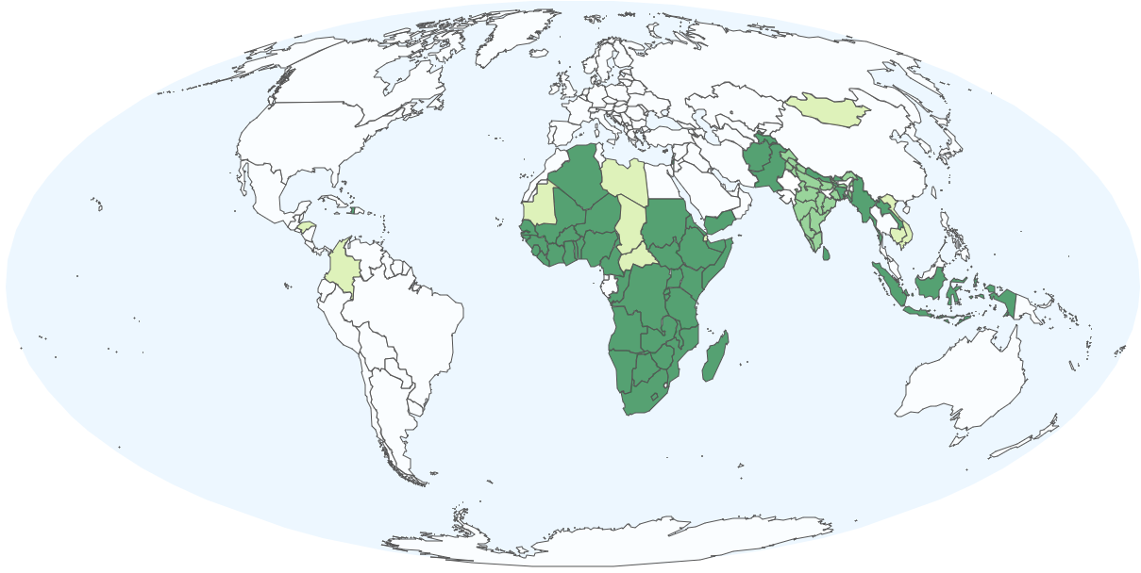
















Growth of the HISP network
Notes:
HISP has since become a +global movement to strengthen Health Information Systems world-wide, as DHIS2 experts--many of whom are former UiO PhD students--have gone on to found and lead HISP groups in Africa, Asia and the Americas.

Slide 6
Growth of the HISP network
Direct country support:
Implementation & maintenance
Capacity building
System integration
Innovative solutions
Notes:
These HISP groups offer long-term +support to country governments on DHIS2 +implementation and maintenance, provide +capacity-building through the DHIS2 Academy program, and work with countries and organizations to adapt +DHIS2 systems and create +innovative solutions to meet local needs.

Slide 7
Collaborating based on shared values
Open-source principles
Local ownership
Sustainability
Transparency
Empowering data use
Learn more: https://hisp.uio.no/
Notes:
HISP groups--together with HISP +UiO--form a global network of partners that shares common values, including +open source principles, +local ownership, +sustainability, +transparency, and +empowering data use.
While each group operates independently, the HISP network as a whole collaborates in a variety of ways.

Slide 8



Action research, assessment and information sharing
+
HISP Groups
HISP UiO
Action research
Best practice through intervention
Assess and evaluate DHIS2 implementations
Explore new domains and challenges
Document findings
Global Public Good
Notes:
In keeping with DHIS2’s +academic origins, a primary area of +HISP collaboration is research. Working +with the Information Systems research group at HISP UiO, HISP groups engage in +action research, uncovering +best practices through targeted country interventions and deep dives. They +assess and evaluate country DHIS2 implementations, +explore new domains and challenges, and +document their findings for input into global products and strategies.

Slide 9
Software requirements, development and testing
+
HISP Groups
HISP UiO
Software requirements
Software development
Field testing of DHIS2 releases
Input and feedback
Notes:
Another key area of collaboration is the +ongoing development of the DHIS2 platform. While +software development is led by HISP UiO, the HISP groups are the most important source of +requirements for software features and +field testing of DHIS2 +releases, due to their close work with country governments. Their +input and feedback is essential to ensuring that DHIS2 continues to meet local needs and function in local contexts.

Slide 10

Software requirements, development and testing
HISP Groups
HISP UiO
Local innovations
Custom applications
Metadata configuration
Modifications to the core platform
Notes:
HISP groups are also a +source of local innovations, such as +custom applications, +metadata configurations, and +modifications to the core platform, developed to rapidly solve specific country challenges. These local solutions are +shared throughout the network and can be adapted by +the core team at HISP UiO for global deployment, followed by +iterative improvements based on further feedback from HISP groups based on real-world experiences.

Slide 11
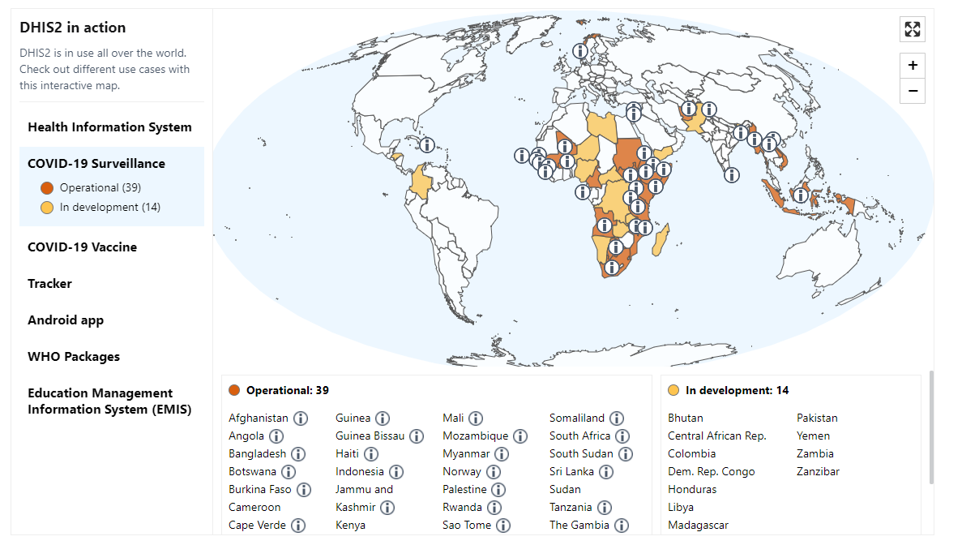


Example: global resource based on local innovation
HISP Groups
Notes:
One example of a +local innovation becoming a +global resource was the +HISP network’s response to the +COVID-19 pandemic, where a DHIS2 program for port of entry screening and contact tracing

Slide 12

Example: global resource based on local innovation
Notes:
developed by +HISP Sri Lanka became the basis for a +metadata package quickly deployed in +almost 40 countries for the COVID-19 response.

Slide 13
HISP Hubs for regional collaboration
System Architecture
Implementation
+
HISP Groups
Research
HISP UiO
Capacity Building Projects
Hubs:
National
Multi-country
Regional
Notes:
+HISP groups also work together in regional hubs on +national, +multi-country and +regional DHIS2 +system architecture, +implementation, +research and +capacity building projects +in collaboration with HISP UiO

Slide 14



Helping produce core products
+
HISP Groups
HISP UiO
Notes:
In addition to this cycle of collaboration between HISP groups in the field and HISP UiO, +individual members from various HISP groups also serve as +members of core DHIS2 teams, where they directly contribute to development of +global metadata packages, +applications, and +training materials.

Slide 15
Summary
HISP
Health Information Systems Programme
The origin of the DHIS software
Perform research and assessment
The driving force in developing DHIS2
Provide input and feedback on DHIS2 software
Provide implementation and maintenance support
Develop and share local innovations
Build local and regional capacity
Ensure that DHIS2 meets local needs
Notes:
The HISP project , was +the origin of the DHIS software, and HISP groups have been +the driving force in developing DHIS2 from a local solution into the world’s largest health information management system. They +provide long-term implementation and maintenance support, +conduct capacity-building, +perform information system research and assessment, +provide input and feedback on software releases, +develop and share local innovations, and +ensure that DHIS2 continues to meet local needs.

Slide 16
Summary
+
HISP
HISP UiO
Notes:
HISP groups are not just a +part of the DHIS2 story--they are the foundation of DHIS2’s history. Without the HISP groups, there would be no DHIS2.

